Slide 1

Reducing Operating Costs
Angeline Chandraatmadja

Slide 2

Content
Problem Statement
Solution
Reducing No. of Questions in the Survey
Simplifying the Questions
Final Result
Potential Improvements

Slide 3
Problem Statement
State of Iowa Government: Reduce the no. of data required to be collected in the housing data set to increase compliance and reduce operating cost
Tax Authorities: Tax authorities said that they still need all the variables in the housing data set for calculating house prices, and have urged the City of Ames to keep the status Quo.
Solution
BEAT THE 35,000 Kaggle Score!
We have invited the Tax Authorities to upload their predictions into Kaggle, and they have gotten a prediction score of 35,000.

Slide 4
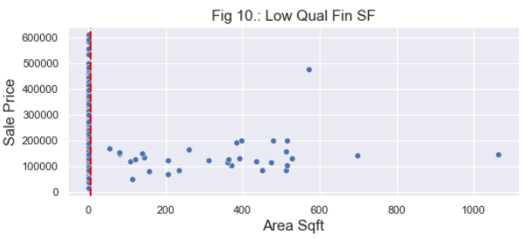
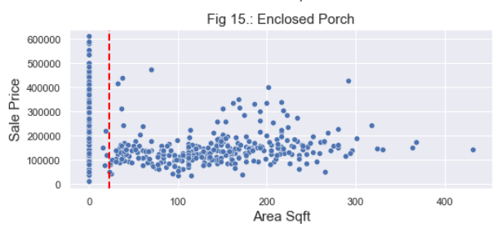
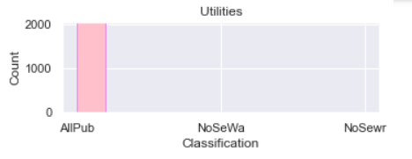
Reducing No. of Questions in the Survey
Remove questions that:
1. Have no correlation to sale price
2. Difficult to calculate
3. Questions that are no longer relevant today as it applies to all houses.

Slide 5
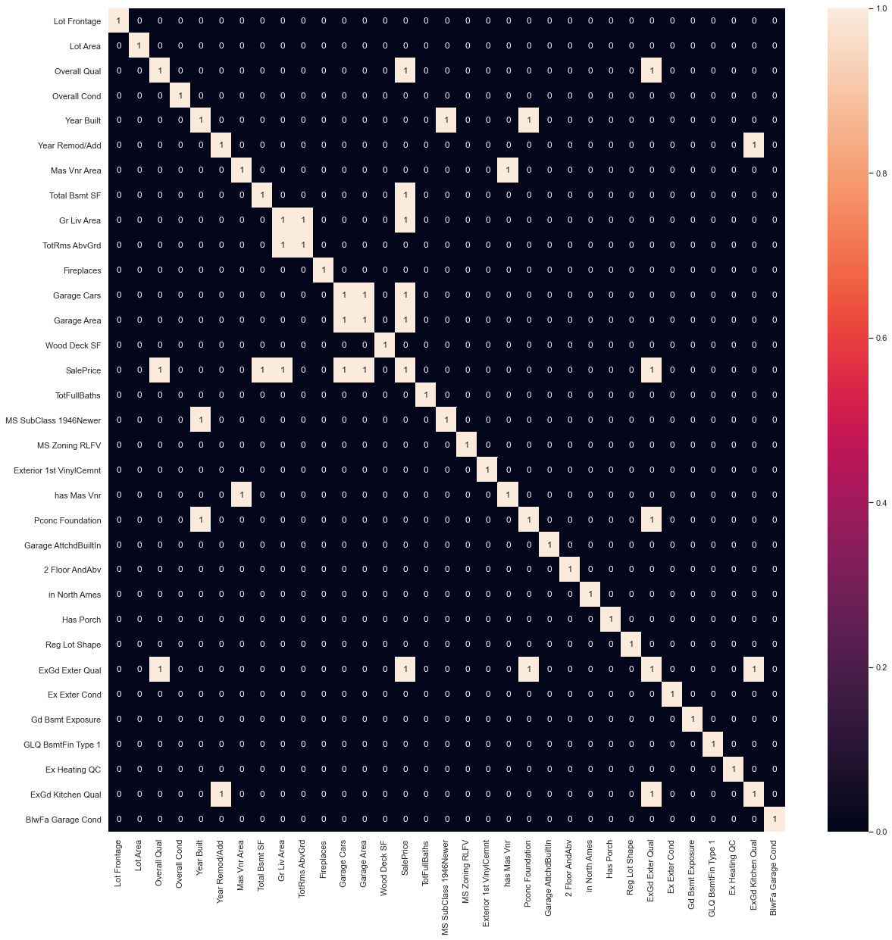
Simplifying the Questions
Variables with higher than 0.63 correlation
Highly similar questions
Remove questions that has high multicollinearity:
Have highly similar results with each other, asking for the same thing but different unit of measurement
Are highly related to each other, Example: Foundation material is trend based
Question is trend based (time related) rather than price related

Slide 6
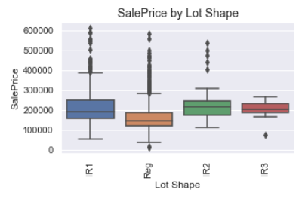
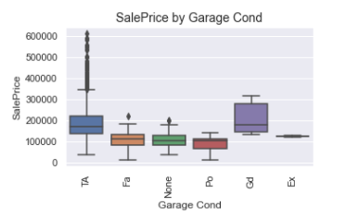
Simplifying the Questions
Some questions have a lot of granularity but not much impact.
Example:
In terms of sale price, there are only 2 group of classes for each of these variables on the right.
That is regular Lot Shape or irregular Lot Shape and Above Typical Garage Condition or none.

Slide 7
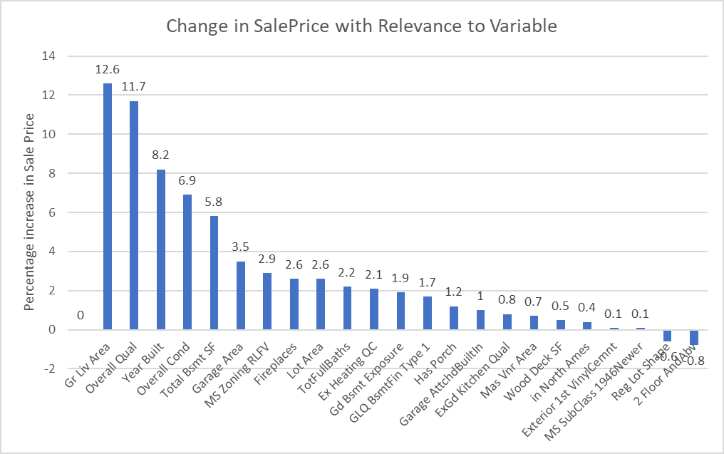
Final Result – the 23 questions that really matters!
Should the Ames County find that this number of features is too much, they may consider to reduce features that least impact prices, as can be seen from the above graph. For instance, Exterior 1st Vinyl/Cement and MS SubClass.
The data above show the variables that are most affecting sale price. For every unit of above ground living area, it will result in a 12.6% increase in price.

Slide 8
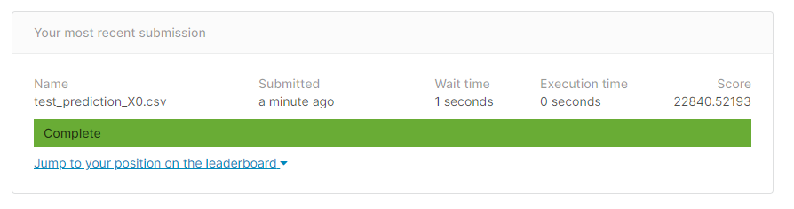
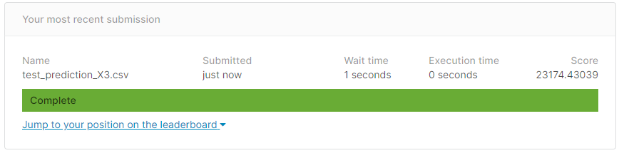
Potential Improvement: Increase training dataset
With data of 2044 columns fitted to train the model…
With 25 % less data - our model will have better predictive analysis with more data!

Slide 9
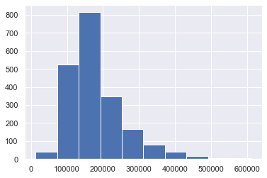
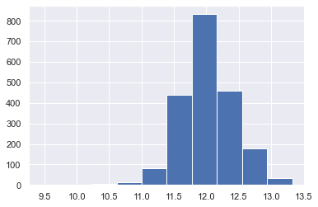
Potential Improvement: applying log to continuous features
Count of Houses vs Sale Price
Count of Houses vs Log(Sale Price)
One of the assumptions associated with a linear regression model is Normality: For any fixed value of X, Y is normally distributed
Hence, converting continuous variables to log variables (making them normally distributed, may improve the predictive capability of the model.
Count
Count
Sale Price
Log(Sale Price)

Slide 10
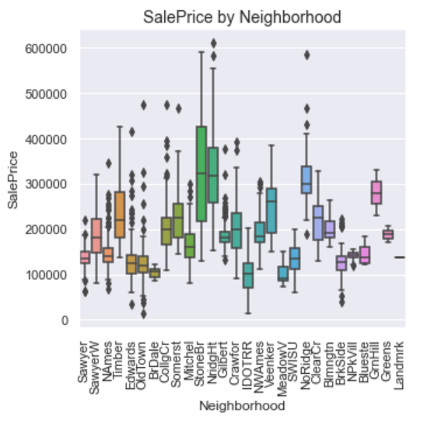
Potential Improvement : Better classifications
From this graph we can see that there are certain neighborhoods that have higher mean than others.
Can be clustered into 4 – 5 different clusters of neighborhoods according to their mean.
We will attempt to see if areas play a role in this.

Slide 11
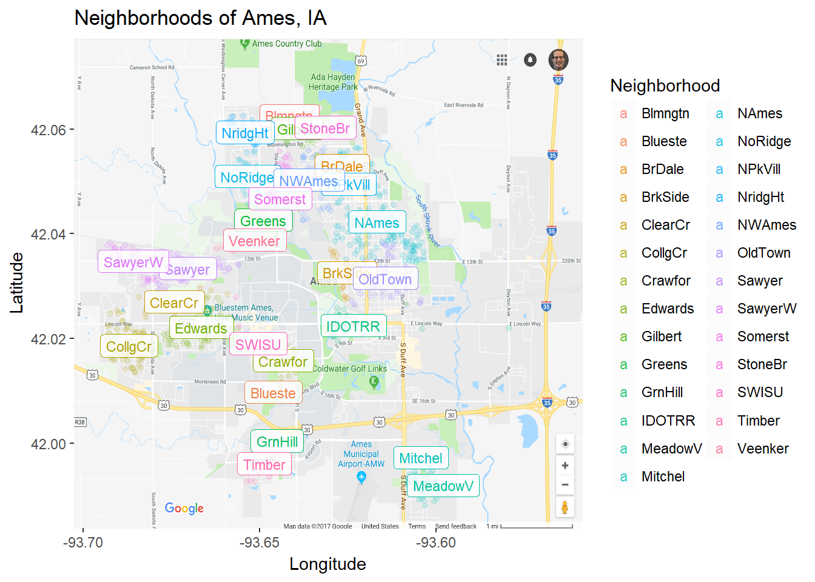
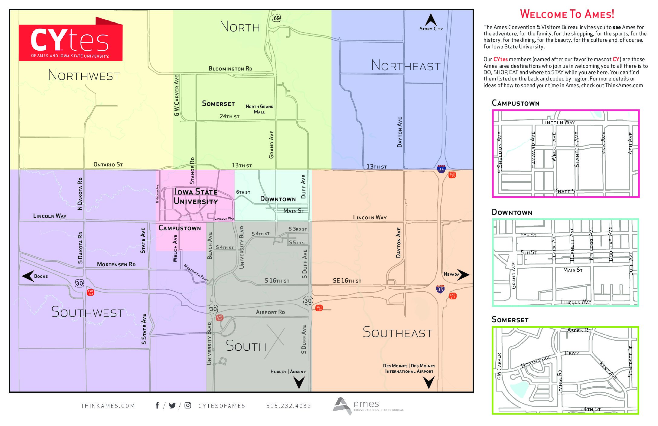
Potential Improvement : Better classifications
North
Northwest
Northeast
We have mapped out the neighborhood into generalized areas
Campustown
Downtown
Southwest
Southeast
South

Slide 12
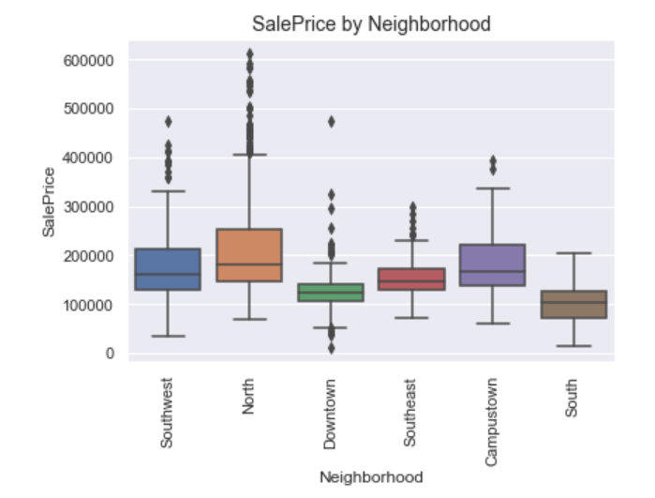
Potential Improvement : Better classifications
However it has instead muted down the difference in the mean between neighborhoods.
Perhaps we recategorizing to different classes of neighborhoods or districts might make our model more accurate.

